Slide 1


CAPSTONE PROJECT KL/SELANGORRENTAL PRICE PREDICTION
SAHILA

Slide 2

KL/SELANGOR RENTAL PRICE PREDICTION
SUMMARY OF THE PROJECT
Problem:
Lets say a homeowner wants to rent his property for some extra income every month. They would want to engage with real estate agents on giving them an indication on their property's worth (price/rent).
When giving indications, agent will simply check property website like mudah, propertyguru, property and adapt the price(s) they choose to derive the indication.
The problem here is that :
the value is adapted from the information shared by others.
the info in the ads may not be complete or simply wrong info.
value is taken from only 2 -3 ads
To find:
Predict a housing rental in terms of rent category.
There will be 3 categories – Low (1.6k), Medium (1.6k-6k) and High (above 6k). The model will be trained based on the low, medium and high categories with other features that influence the rental price such as location, number of rooms, bathrooms, parking, size, property type, furnishing and various amenities.

Slide 3
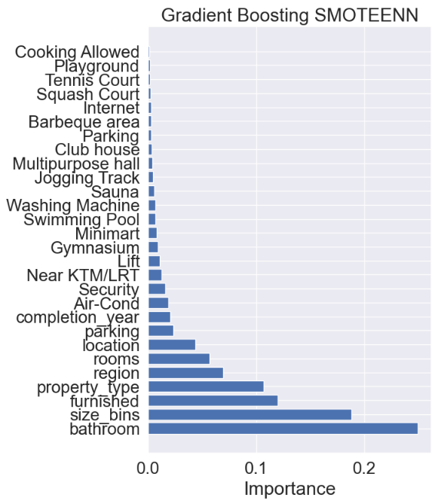
KL/SELANGOR RENTAL PRICE PREDICTION
SUMMARY OF THE PROJECT
Models used: Logistic Regression Decision Trees, Random Forest and Gradient Boosting
Result: From the accuracy, the model managed to predict the categories. But with limited reliability on the high category due to an imbalanced dataset. This can be improved by exploring ways to “rebalance” the data.
Train and Test Scores: GBR 4 has the highest test score (0.8655) and train score (0.9960).
Cross-validation Score: GBR 4 also has the highest cross-validation score (0.9833), indicating good generalization.
MCC (Matthews Correlation Coefficient) - Test: GBR 4 has the highest MCC (0.7107), indicating a better balance between precision and recall for different classes.
ROC AUC Score: GBR 4 has the highest ROC AUC score (0.9535), indicating better overall performance across all thresholds.
F1 Scores: GBR 4 has the highest F1 Score on both the train (0.9960) and test (0.8661) sets.

Slide 4
KL/SELANGOR RENTAL PRICE PREDICTION
SUMMARY OF THE PROJECT
Finding and risk/limitation:
An imbalanced dataset can affect the model in terms of bias towards the majority category.
Due to the bias, if the model is deployed in a market with a higher proportion of "high" rentals, its predictions might be unreliable.
Rental Market Representation: The data is assumed to be representative of the actual rental market distribution. If the data comes from a specific source or region with a unique rental landscape, it might not generalize well to other markets
The real estate market varies from one area to another area. This model is adapted from around KL/Selangor areas (not a full state coverage).
Deployment:
Deploy it as an app using nginx and gunicorn and then linked it to a domain using namecheap
Usage:
Fill in info such as location, property type, number of rooms, bathroom, parking, furnishing and available amenities within the property and generate results.
Benefit:
Due to the hectic nature of working, this will benefit the agents/valuers in simplifying the indication works. It assists real estate agents, valuers give an indication to their customers. OR homeowners to check the possibility of their property’s rental rates (range).
Hassle-free and time saving.

Slide 5

THANK YOU

